Slide 1


Slide 2
TOPIC
Purchase Contracts

Slide 3
Purchase Contracts
Definition of Pruchase Contracts:- Purchase contracts are used to register specific agreements with a buy-from business partner to delivery of specific goods.
Purchase Contracts:-There are two types
1.Normal Contracts.
2.Special Contracts.
1.Normal Contracts:-Normal Contracts are the contract that are general contracts done with the suppliers
2.Special Contracts:-Special Contracts are the contracts that are specially specified contracts done with the supplier.

Slide 4
Origins for Purchase Contracts
These Origins are used to search the purchase contracts
1.Purchase Order line
2. Purchase Schedule
3. Planned purchase order in Enterprise Planning

Slide 5
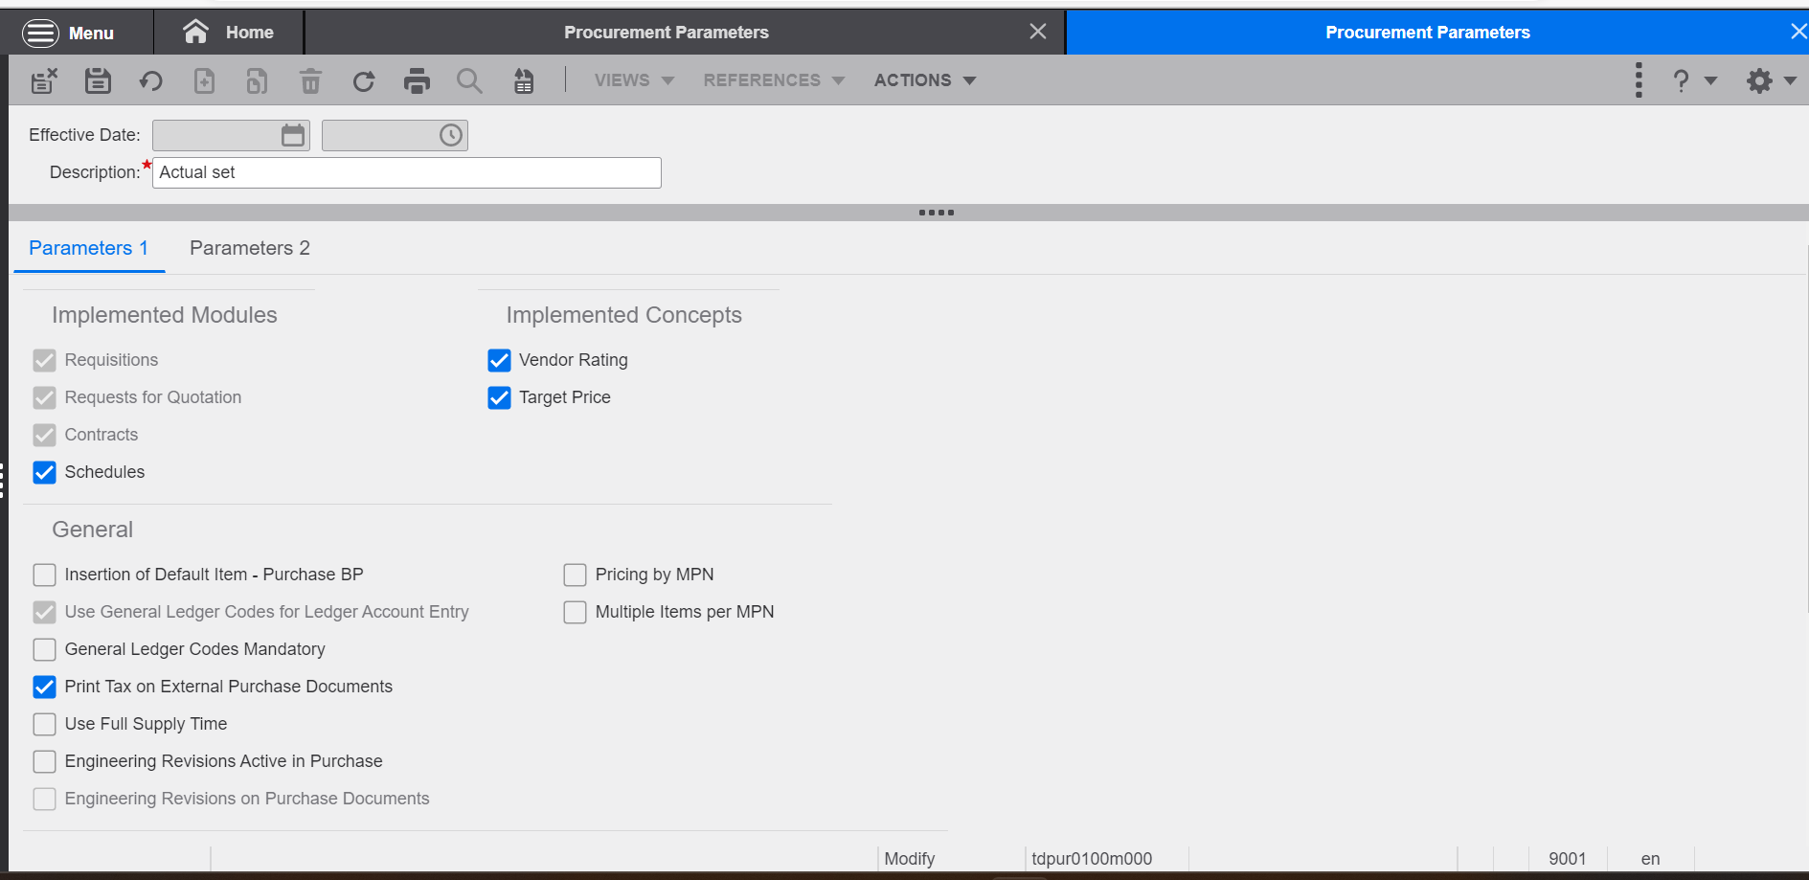
First step for the Purchase Contracts
First we need to enable the check box in the purchase parameter (tdpur0100m000)

Slide 6
Parameter Set-up for Purchase Contracts
Maintaining Contracts Always Allowed :-We need to enable the check box for contracts which turnover is already booked. If this check box is selected, you can reset the contract status to Free if the status is Active.
Copy Special contracts to Normal Contract:-If we enable the check box you are allowed to copy special contracts to normal contracts in the Copy Purchase Contracts (tdpur3801m000) session.
Copy Normal Contract to Special contracts :-If we enable the check box you are allowed to copy normal contracts to special contracts in the Copy Purchase Contracts (tdpur3801m000) session.
Evaluate Contract before Deleting:-If we enable the evaluate contracts before deleting we need to delete the contracts then only we need to change the status of purchase contracts to terminated.

Slide 7
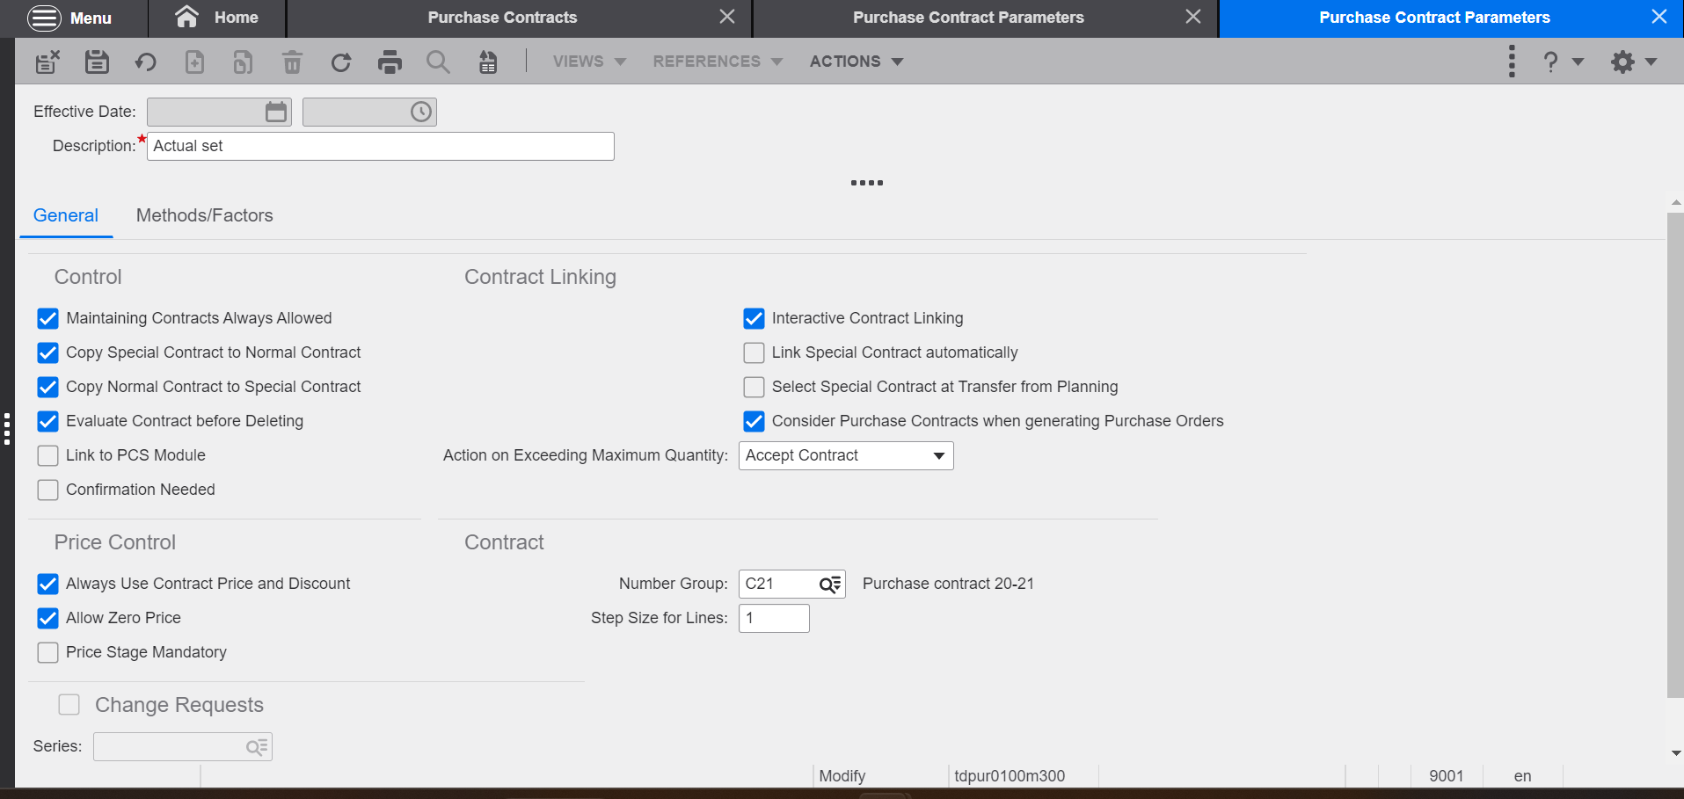
Purchase Contract Parameters (tdpur0100m300)
Need to set-up purchase contract parameters as per our requirement

Slide 8
PURCHASE CONTRACTS (tdpur3100m000)
Navigation to open the purchase contracts:-
Procurement
Contracts
Click on New Purchase contracts

Slide 9
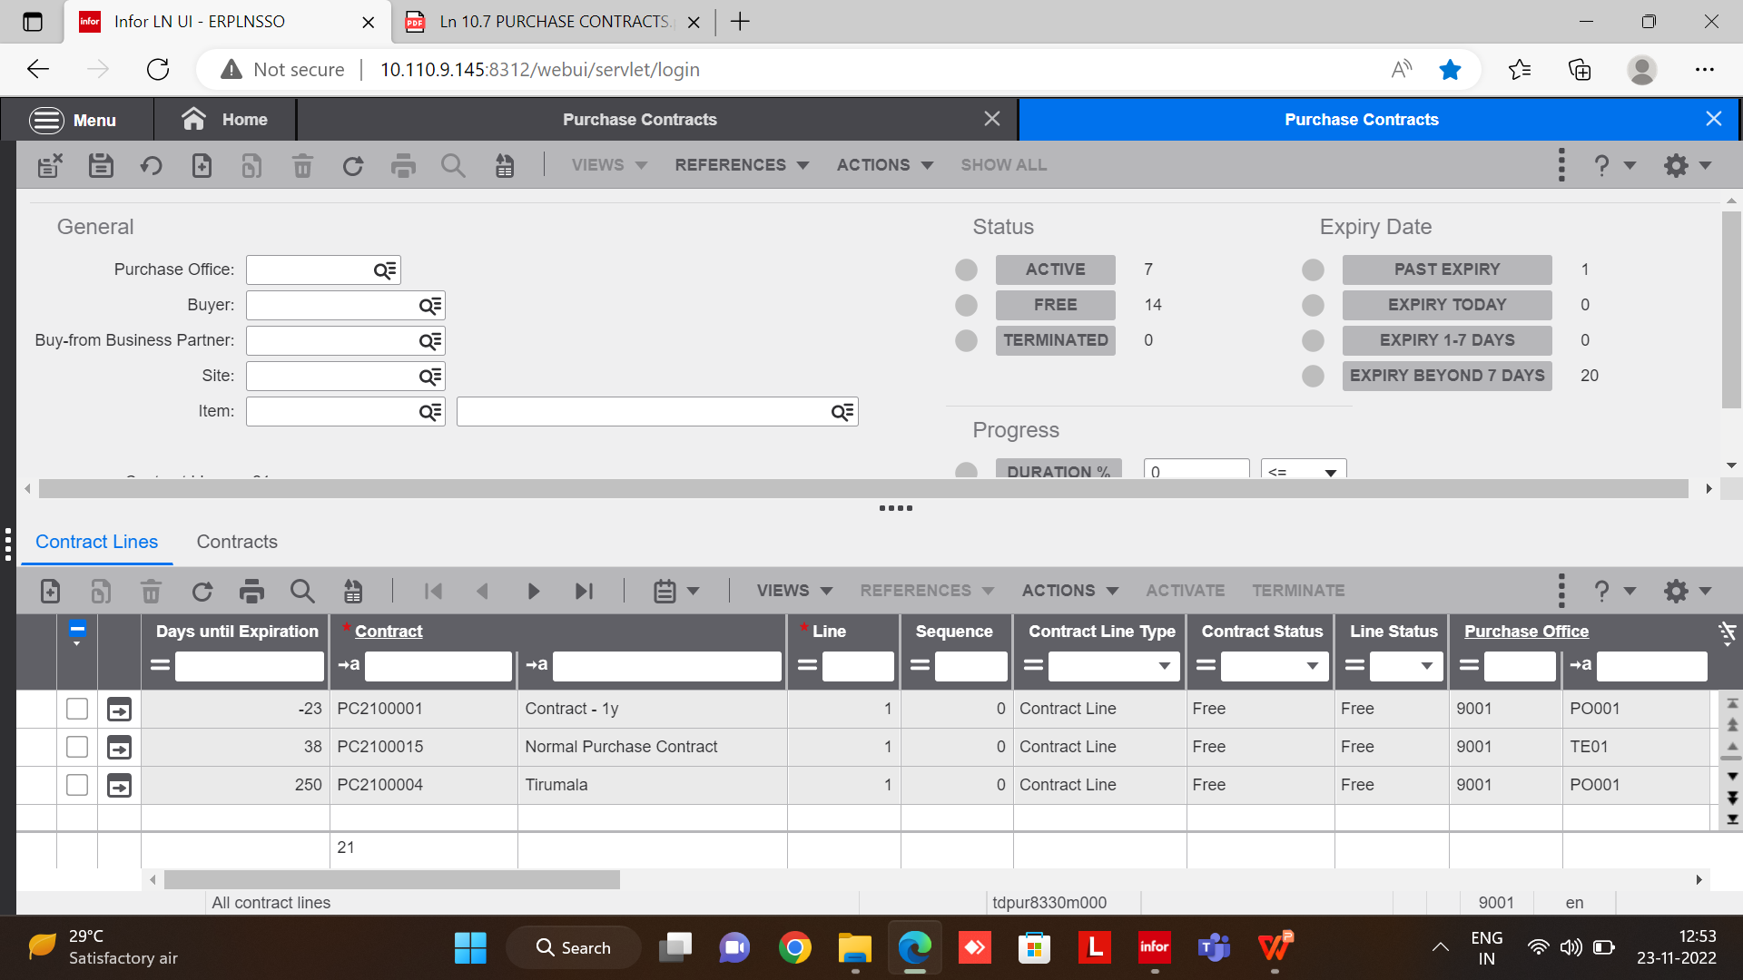
PURCHASE CONTRACTS WORK BENCH

Slide 10
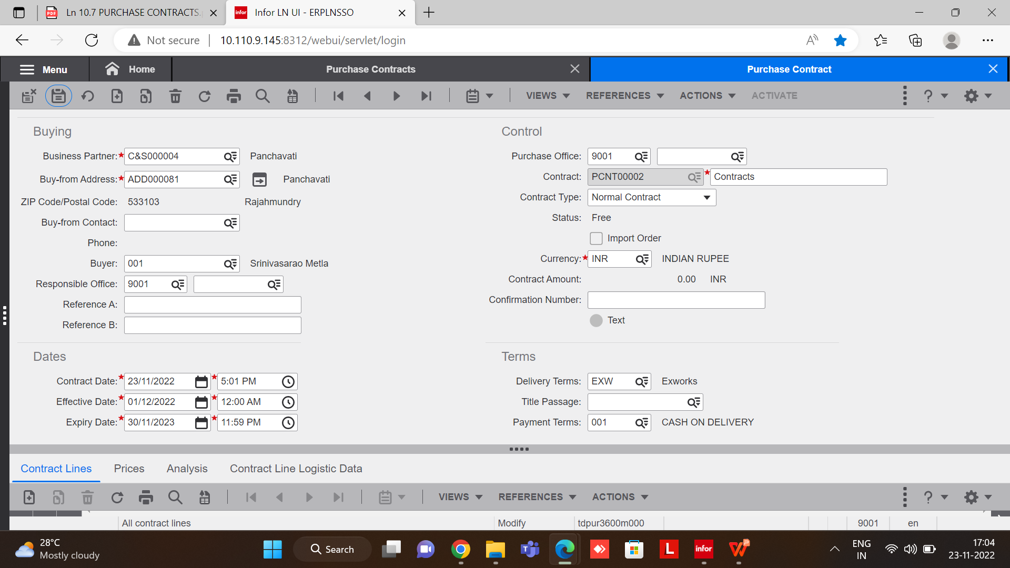
PURCHASE CONTRACT
Mandatory fields:-
▪ BP Prices/Discounts or Buy-from Business Partner
▪ Ship-from BP
▪ Item
▪ Purchase Price Group
▪ Purchase Office
▪ Effectivity Unit
▪ Effective Date
▪ Expiry Date
Note:- Save the purchase contracts

Slide 11
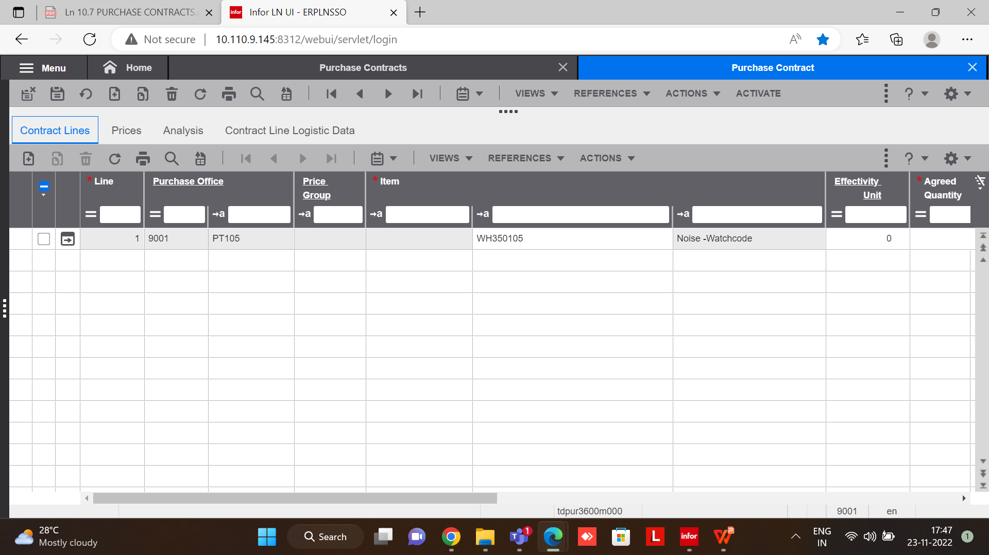
CONTRACT LINES TAB
Mandatory fields:-
1.Purchase office
2.Item
3.Agreed Quantity
Note:-Mandatory field (purchase office)
we need to enter the site purchase
otherwise we are not able to do the transaction

Slide 12
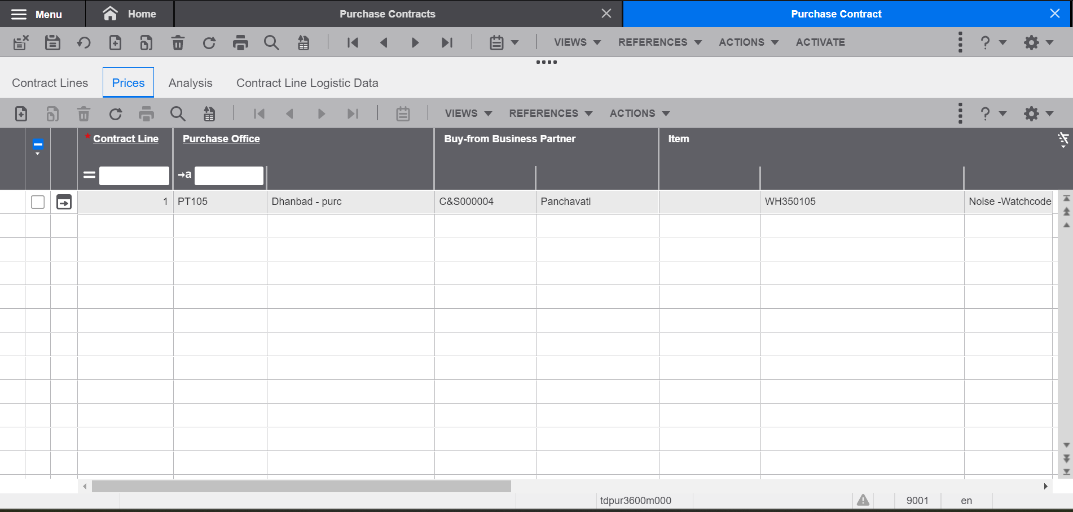
PRICES TAB
Need to maintain prices and discounts
Note:-For suppose we haven’t maintain any amount in the price tab ,
The ACITIVE tab will not display

Slide 13
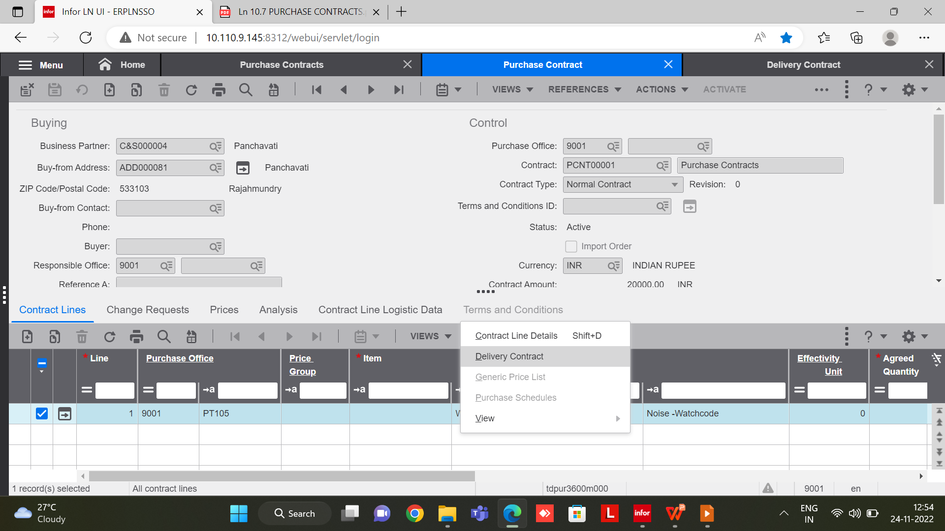
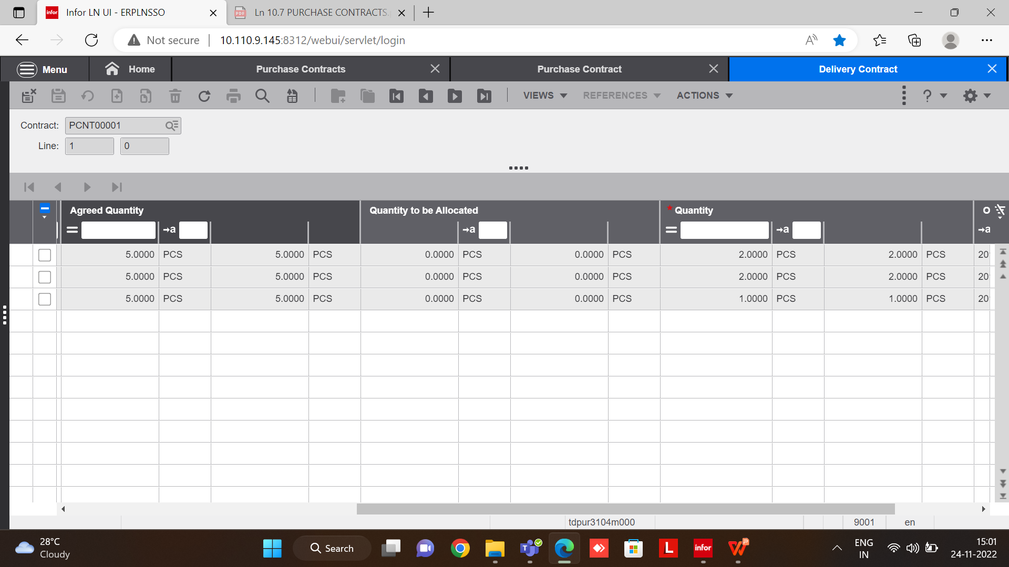
Delivery Contracts
In this tab we can maintain delivery contract schedule wise
If the quantity is exceded more than the given quantity we are not able to add more than the quantity.

Slide 14
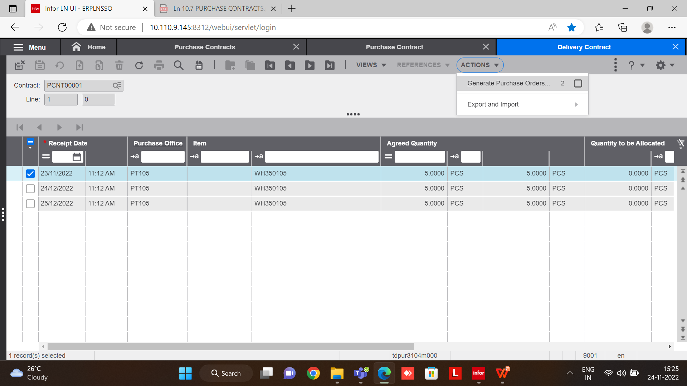
GENERATE PURCHASE ORDERS
From the actions tab we can able to generate the purchase orders

Slide 15
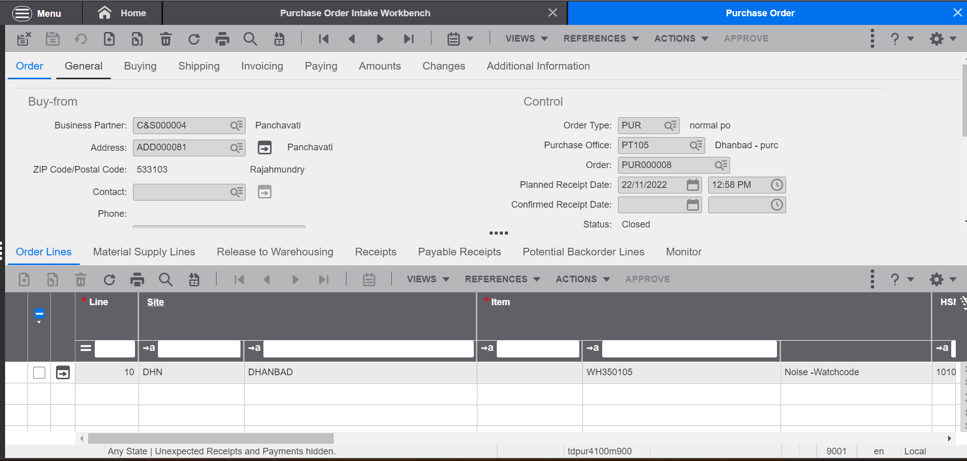
GENERATED PURCHASE ORDER

Slide 16
PURCHASE CONTRACT CHANGE REQUESTS
At the middle of the purchase contract we can able to change
Category | Fields
Pricing terms | Price Stage, Price, Discount
Delivery terms | Delivery Terms, Ship-from Address, Receiving address (warehouse), Delivery Location, Delivery Date, Ship-to BP, Carrier
Payment terms | Payment Terms, Payment Address, Point of Title Passage
Order reference | BP Order Number, Reference A, Reference B, Buyer, Text
Quantity | Agreed Quantity
Item | Item, Manufacturer Part Number, Unit Effective Number, E-Item Revision

Slide 17
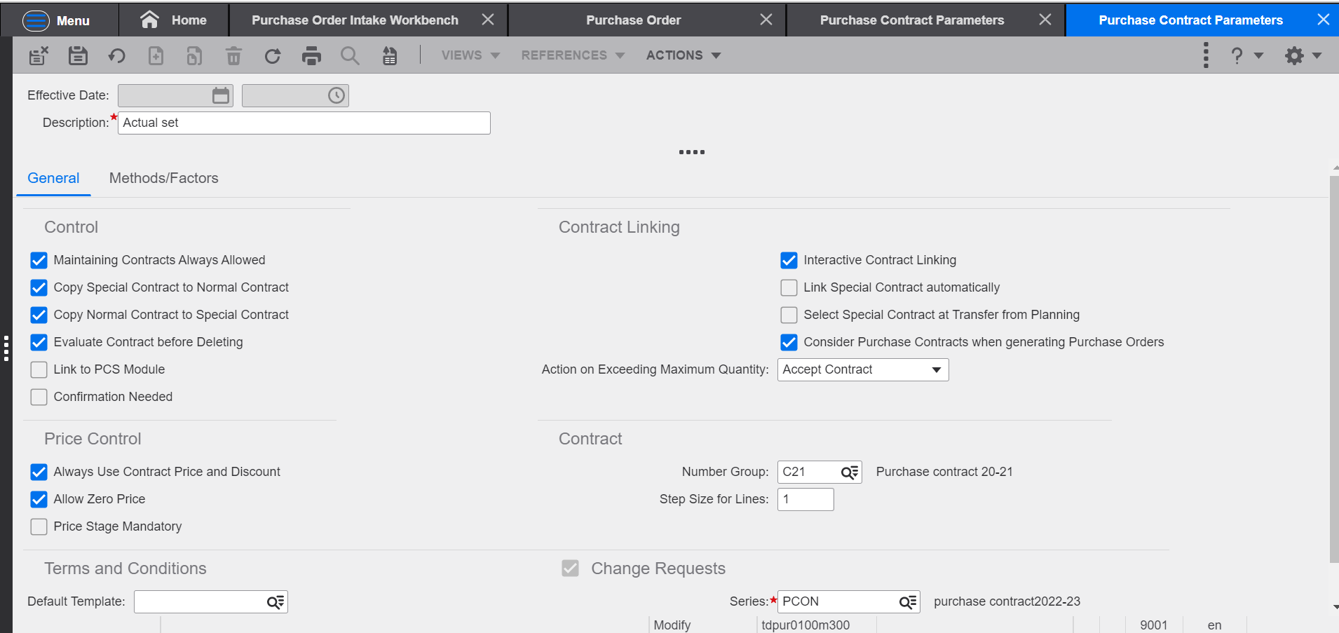
CHANGE REQUEST SET -UP
Purchase Contract Parameters (Change request)

Slide 18
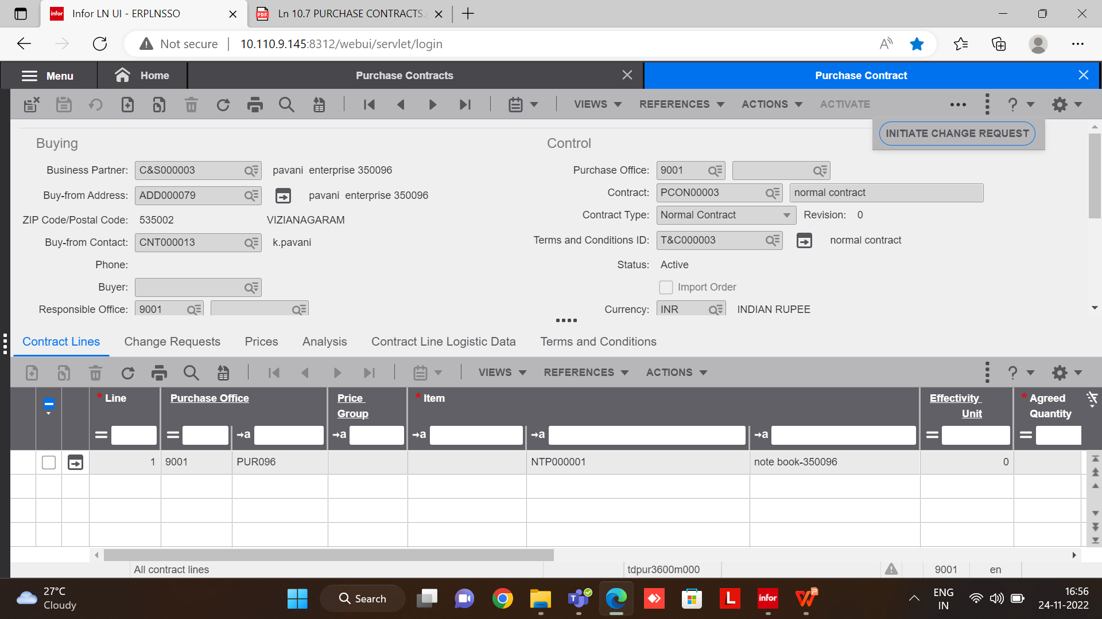
CHANGE REQUEST
If we click on the INITIATE CHANGE REQUEST then we can able to change request.

Slide 19
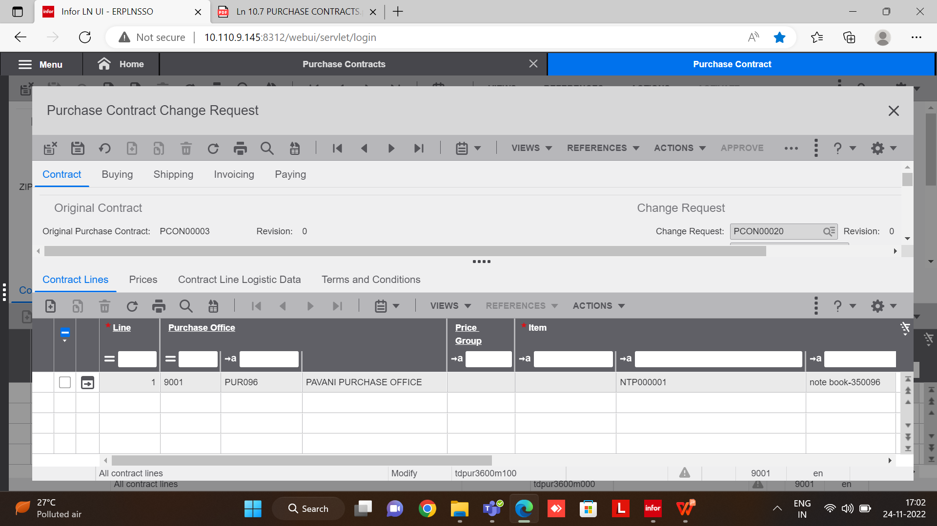
CHANGE REQUEST
Here we can able change the needed fields
After Changing the fields we need to APPROVE
Status Change modify to Closed

Slide 20
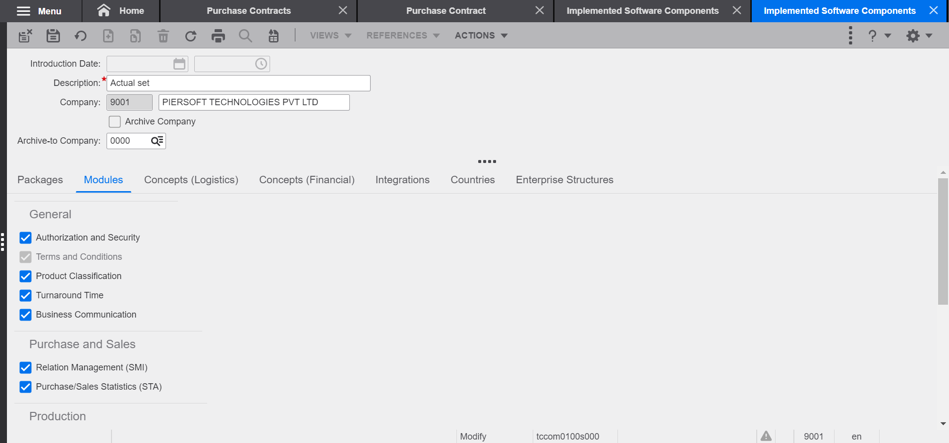
TERMS & CONDITIONS
Implemented Software Components(tccom0500m000)
Purchase Contract parameters(tdpur0100m300)

Slide 21
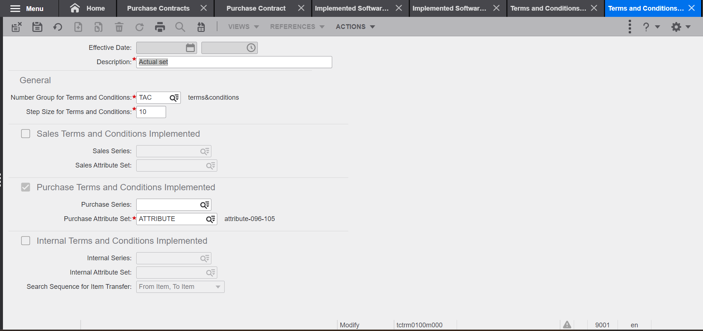
TERMS & CONDITIONS
We need to set -up Terms and conditions parameters(tctrm0100m000)

Slide 22
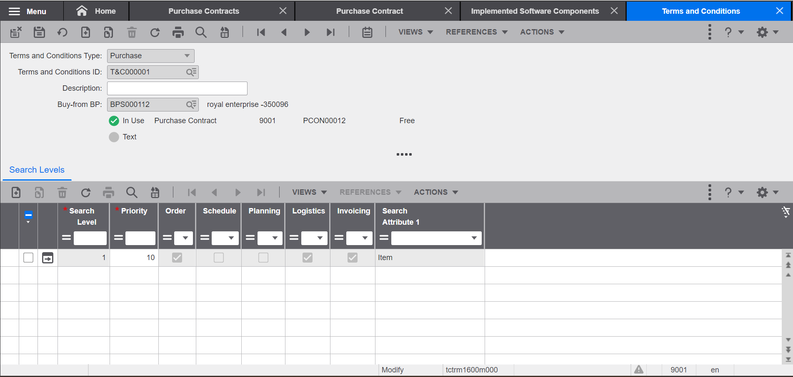
TERMS & CONDITIONS
We need to set -up Terms and conditions(tctrm1600m000)
For the particular Business partner we had maintained the terms and conditions
Here we need to set-up the Search attributes

Slide 23
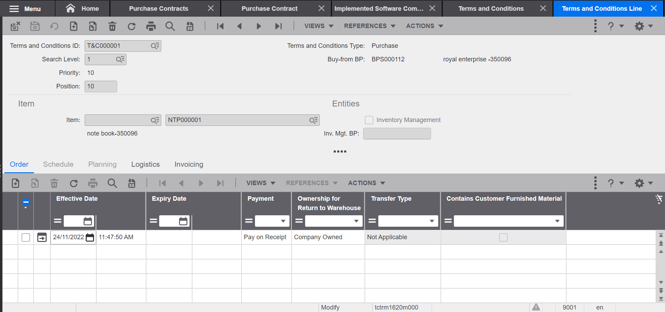
TERMS & CONDITIONS
Here we need to set -up Terms and conditions line(tctrm1620m000)

Slide 24
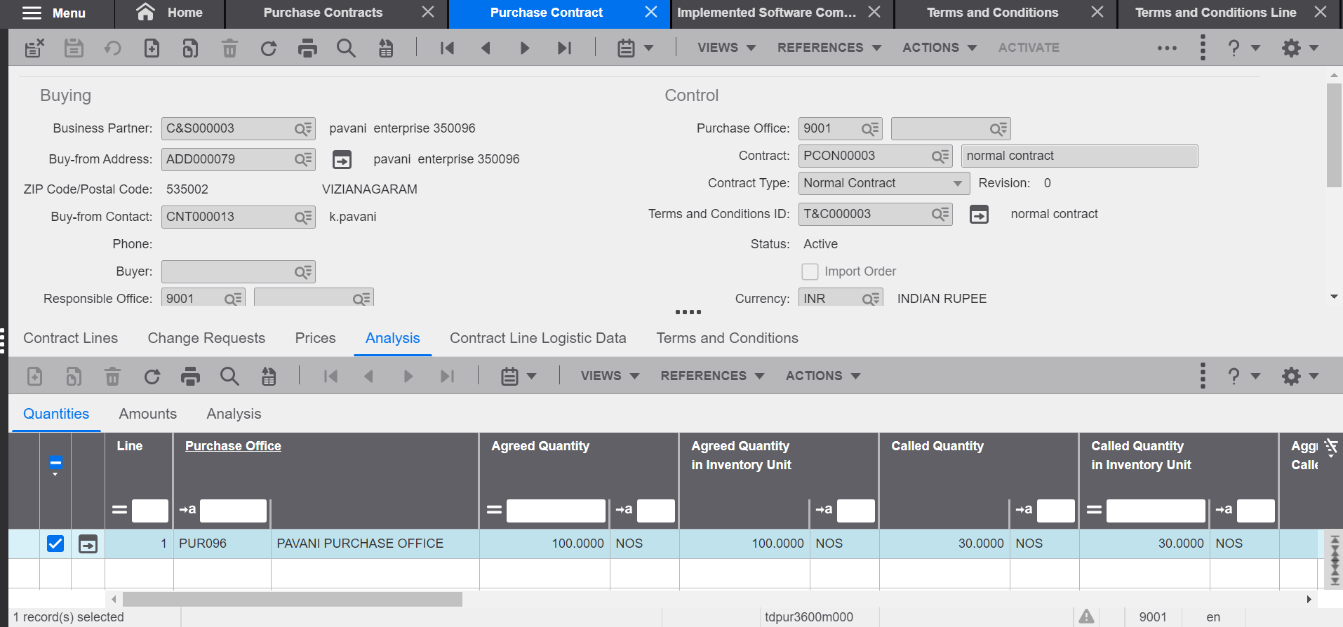
TERMS & CONDITIONS
Its a manditaory field to maintain the terms and condition ID field in the header level
Then trems and conditions tab will be enabled in the line level

Slide 25
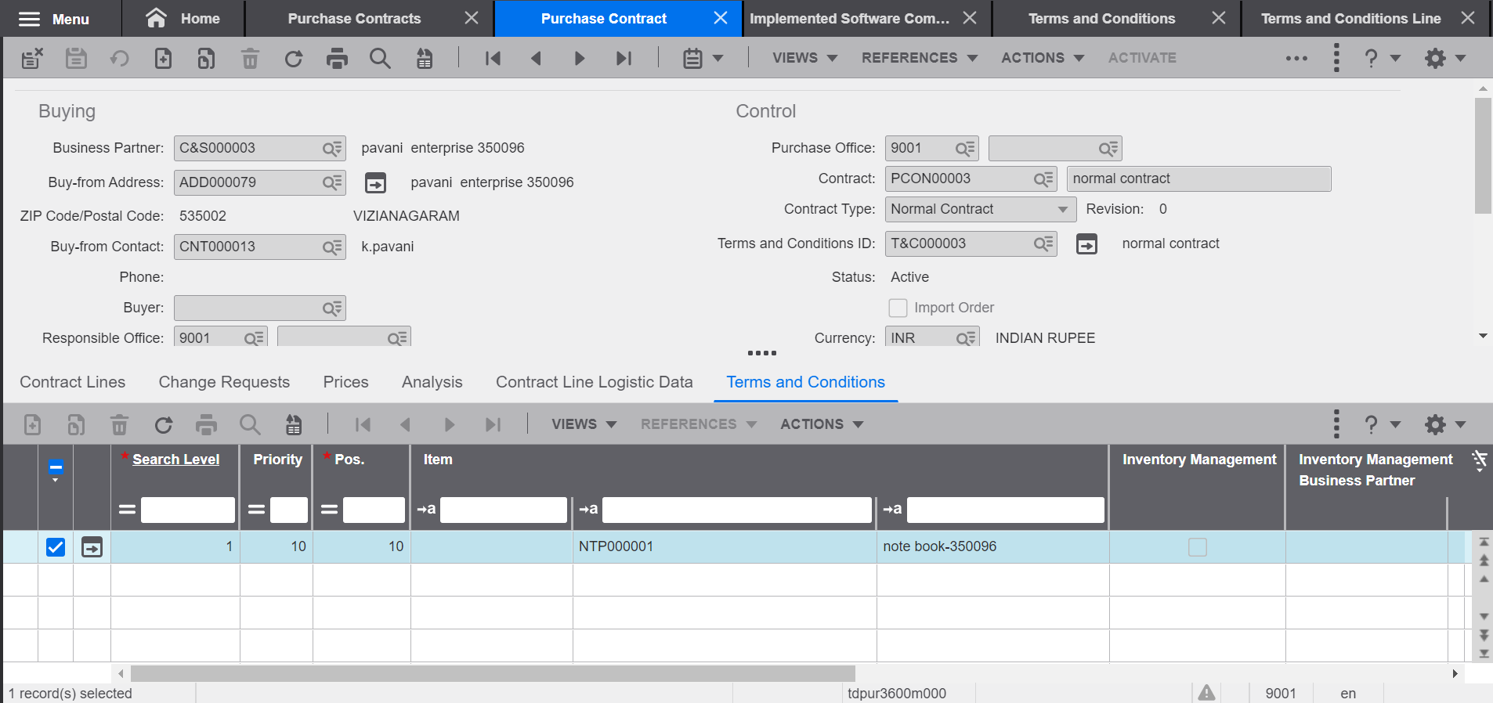
TERMS & CONDITIONS
In the line level we can maintain item wise terms and conditions

Slide 26
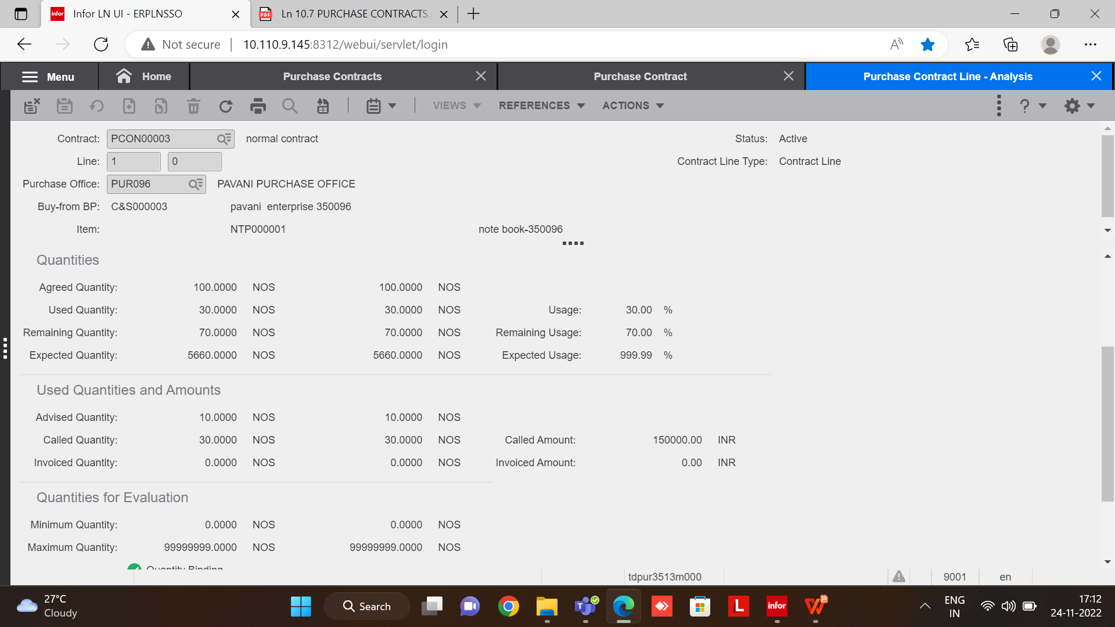
PURCHASE CONTRACT LINE - ANALYSIS
Qunatities :-
1.Agreed Quantity
2.Used Quantity
3.Remaining Quantity
Used Quantities:-
1.Adviced Quantity(Already generated Quantities but need to recive)
2.Called Quantity(Already recived)
3.Invoiced Quantity(Invoice generated Quantities)

Slide 27


